Slide 1
Seasonal flu prediction model
By nicholus magak

Slide 2
1. Business Understanding
Premise:
As the world struggles to vaccinate the global population against COVID-19, an understanding of how people’s backgrounds, opinions, and health behaviors are related to their personal vaccination patterns can provide guidance for future public health efforts. Your audience could be someone guiding those public health efforts.

Slide 3
1. Business Understanding
Desired outcome:
Create a model that can accurately predict whether a person, based on their attributes given in the data both categorical and continuous is most likely given the seasonal flu (or depending if there is time, the H1N1) vaccine(s).
Eventually, the prediction algorithm can be used in identifying people with potential illness to the seasonal flu and either prevent or have a concrete solution in place due to early detection.

Slide 4
2. Data
The data consists of features/ variables that describe the outcome we want to predict i.e., Seasonal flu vaccinated or unvaccinated.
Due to the balanced data, the goal of the prediction was to focus on the model’s ability to achieve accuracy.

Slide 5
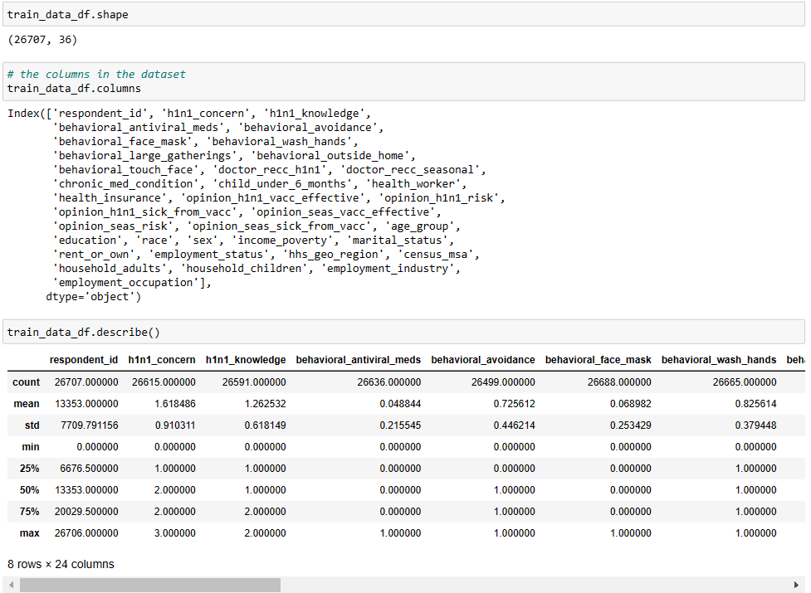
2. Data
Layout of the columns and the data shape of the dataset.

Slide 6
3. Methods
The methods used to build the classification model are: Logistic Regression, Decision Tree Classifier, and Gaussian Naïve Bayes Classifier.
All the 3 methods were trained from data prepped from a train split. This ensured that we would have less chances of overfitting the model and having poor performance on the test set.
Each of the methods had their own levels of tuning with their own respective hyperparameters. The models underwent training through grid search cross validation hence the result is the best potential fit out of the give parameters and hyperparameters.

Slide 7
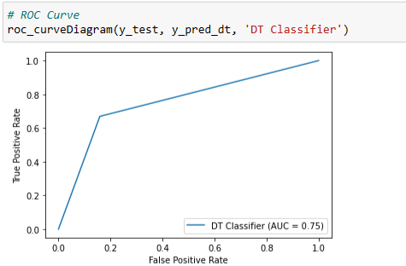
4. Results
When the data was fit onto a Decision tree classifier and the model used to predict test data, the ROC was 0.75.
The outcome was generally very good, however, there are more models available, hence it was important to know if this model had the best predictive ability or there was a chance to get a better mapping.

Slide 8
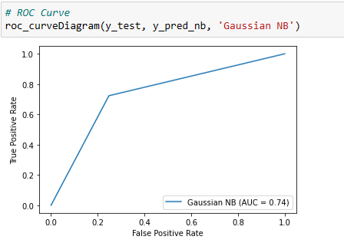
4. Results
When Gaussian Naïve Bayes was used to predict the test data, the overall outcome wasn’t better than the decision tree.
The difference wasn’t much to complain about, however, the search for a better model was still on.

Slide 9
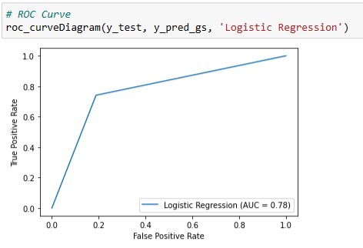
4. Results
Finally, which was a tweak of the baseline, the tuned logistic regression. It performed the best out of the models created to fit the binary classification in the project.
This is what I would use when it would come to prediction of who has or hasn’t received the seasonal flu vaccine. With a ROC of about 0.8, I feel this is an acceptable range of fit for the model to be public.

Slide 10
Conclusion
Yes, the model did well, but I believe with what we have seen from the individual models, if we were to combine their strengths and potentially avoid some of their weaknesses through an ensembled model, we would have an aggregate that would surpass the logistic regression.

